Slide 1
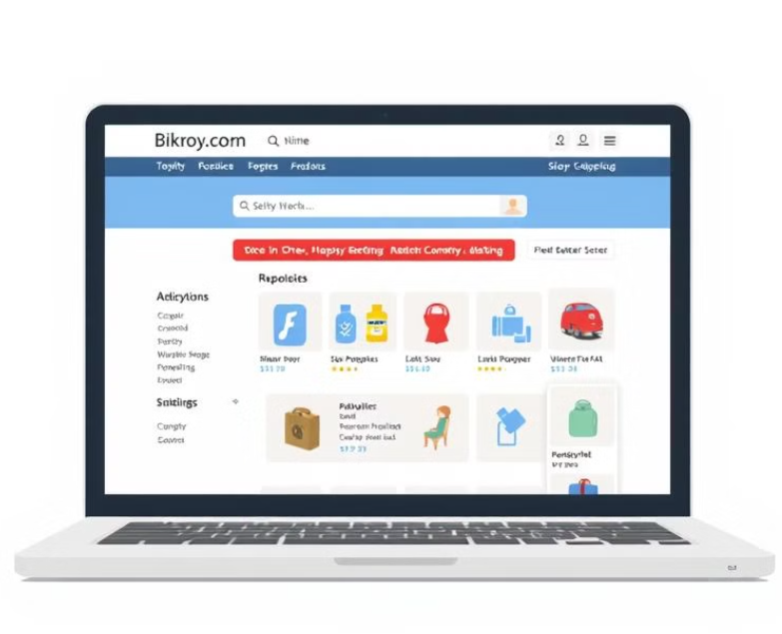

Analyzing the Bikroy.com Model for C2C Business
Presented by:
Name: Shrabon Das
ID: 2230827
Course: E-commerce & Web Application

Slide 2
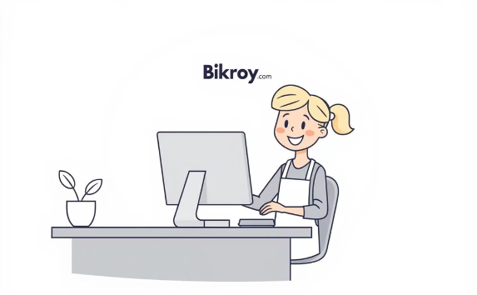
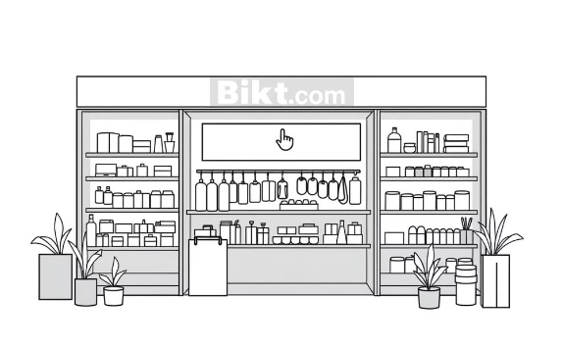
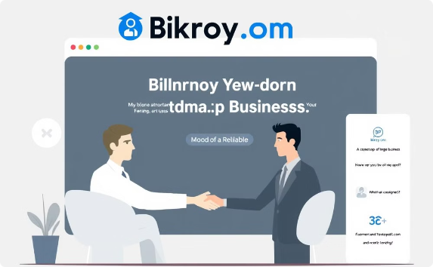
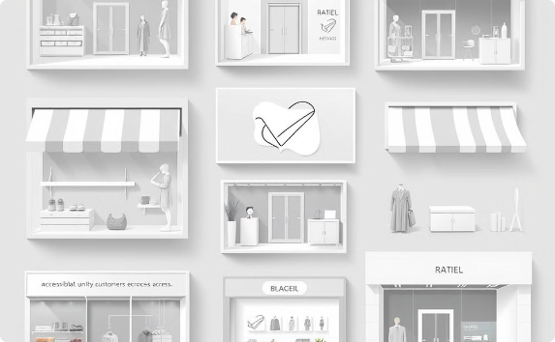
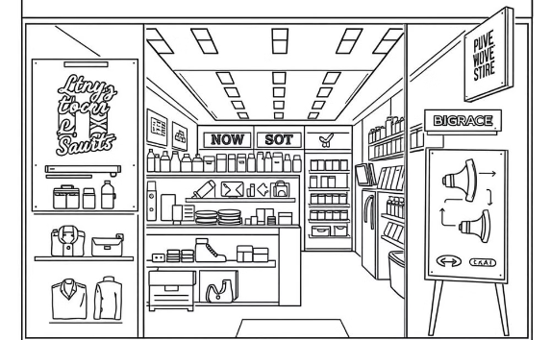



Bikroy.com: Empowering Businesses in Bangladesh
Member
Verified Seller
Authorized Dealer
Basic benefits for small sellers
Increased visibility, trust
Maximum platform support
Virtual shops
product discovery
customer support
Virtual shops accessible nationwide.
Enhanced product discovery with ads and promotions.
Dedicated customer support for business members.

Slide 3
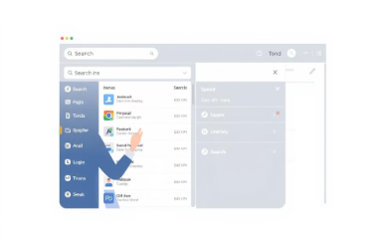
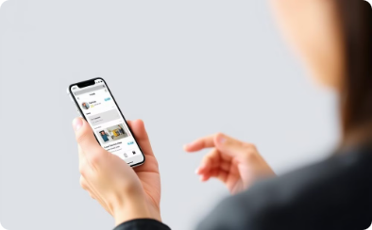

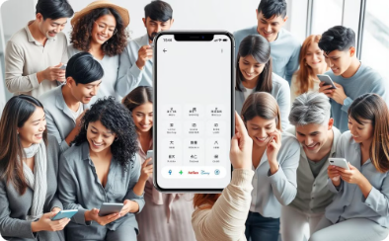


Web Usability Guidelines for C2C Platform
Navigation
Mobile First
Building Trust
Accessibility
Streamlined registration, intuitive search
Seamless experience across all devices
Verified sellers, secure payments, reviews
Multiple languages, clear interface

Slide 4
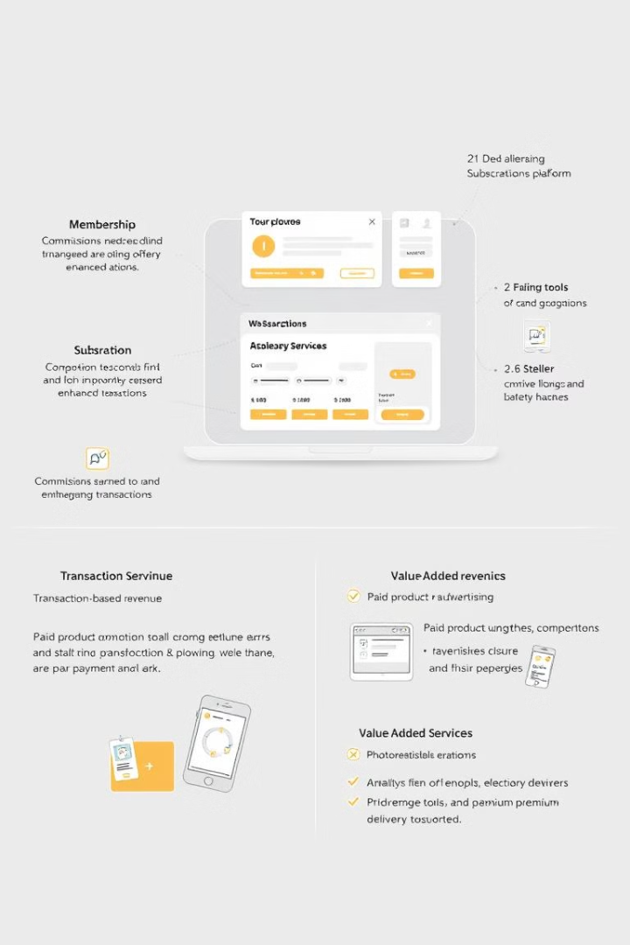

Sustainable Revenue for C2C Businesses
Membership Subscriptions
Transaction-Based Revenue
Paid tiers with enhanced features
Commissions on sales and payments
Promotions & Advertising
Value-Added Services
Analytics tools and premium delivery
Paid product promotions and seller ads

Slide 5


Thank you for your time!

